Slide 1
Bayesian Stsatistics

Slide 2
Introduction

Slide 3
Introduction
What is Bayesian?
Statistical view, machine learning view
Why Bayesian?
prior -> shirankage, fast fit, …
multi level model(graphical model)
interpreterbility -> measure the uncertainty

Slide 4
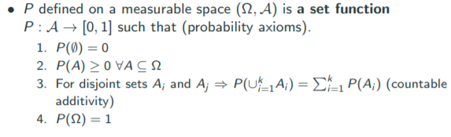
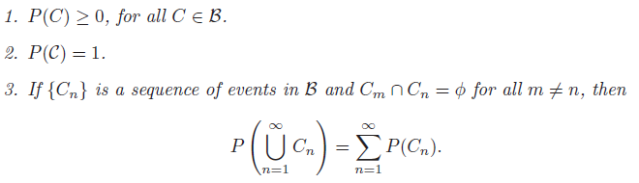
Elementary statistics
Probability(lecture)
Probability(Hogg

Slide 5
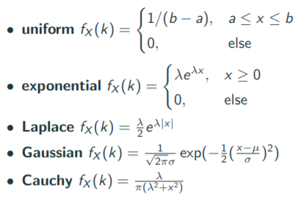
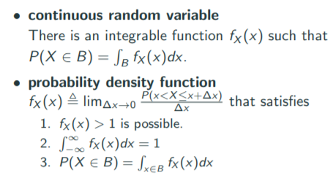
Gaussian distribution

Slide 6
Gaussian distribution
It is the continuous distribution with the maximum entropy for a specified mean and variance
Zero skewness and kurtosis
CLT
Approximations

Slide 7

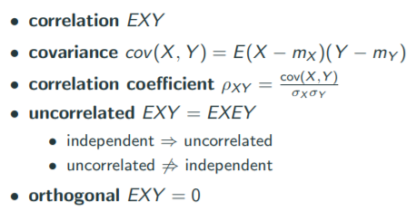
Expectation

Slide 8
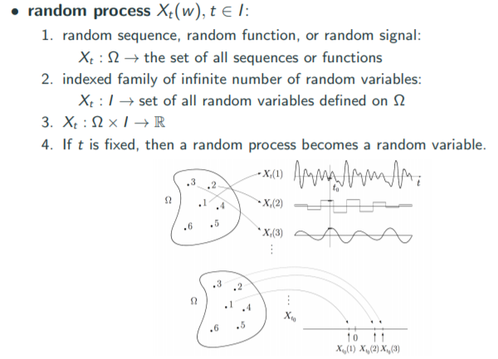
Random process

Slide 9
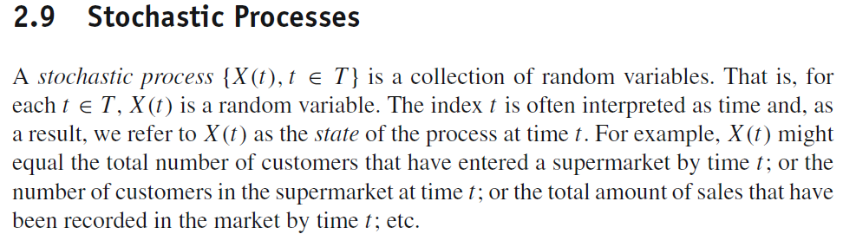
Random process(Ross)

Slide 10
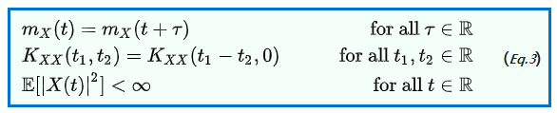
Stationary
Strict stationary
Week stationary

Slide 11
Bernulli and beta distribution

Slide 12

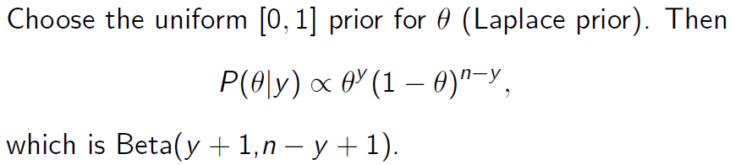
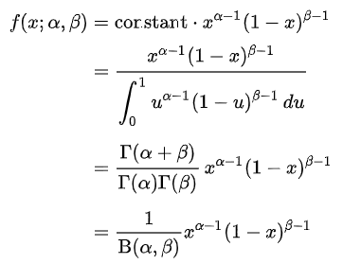
Beta distribution

